Slide 1
Temperature and Humidity Monitoring System
S ARAVIND 210701032
P ARVIND 210701034
V ADHI BALAJI 210701015

Slide 2
ABSTRACT :
This project presents a cost-effective Temperature and Humidity Monitoring System utilizing Arduino Uno, DHT11 sensor, and an I2C LCD panel. The system offers real-time monitoring and display of environmental conditions, suitable for indoor climate control and industrial processes. The DHT11 sensor ensures precise measurements, while the Arduino Uno handles data processing. Integration with an I2C LCD panel provides a user-friendly interface. This paper outlines the system's architecture, components, and implementation, emphasizing simplicity and versatility. Experimental results validate its accuracy and reliability, making it an effective environmental monitoring tool.

Slide 3
OUTLINE :
Abstract
Block Diagram
Proposed System and Novelty
References

Slide 4
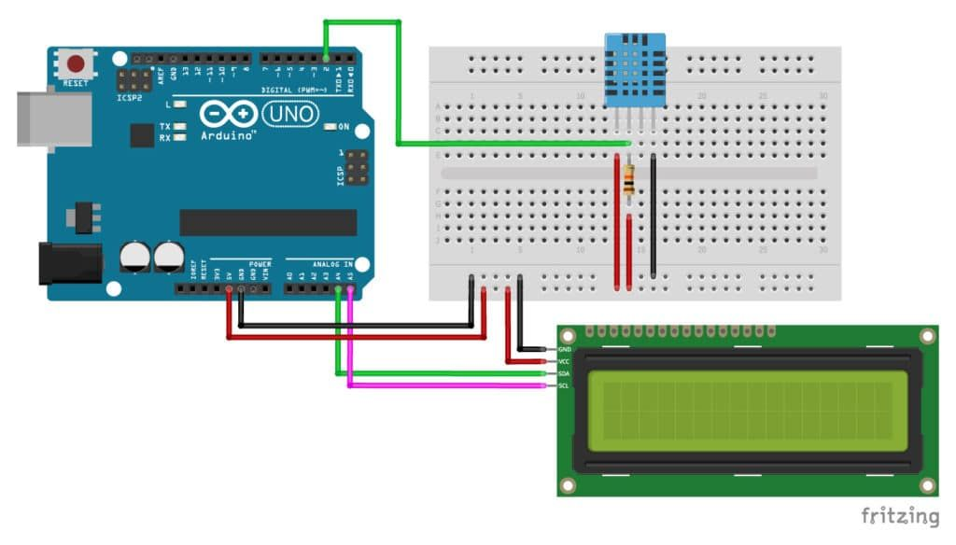
BLOCK DIAGRAM :
DHT11 Sensor
I2C 16x2 LCD Display
Arduino UNO

Slide 5
PROPOSED SYSTEM :
The temperature and humidity monitoring system utilize an Arduino Uno microcontroller interfaced with a DHT11 sensor to collect environmental data. The collected data is then displayed on an I2C LCD display for local viewing. Additionally, a Bluetooth module is incorporated to transmit the sensor readings wirelessly to a mobile application. The mobile app, designed to run on smartphones, provides real-time monitoring of temperature and humidity levels, offering users convenient access to environmental data from anywhere. This integrated system offers an efficient and user-friendly solution for monitoring and managing environmental conditions in various settings

Slide 6
REFERENCES :
Arduino Docs : https://docs.arduino.cc/
DHT11 Sensor : https://www.geeksforgeeks.org/temperature-sensor-types-of-sensor/
I2C Display : https://www.geeksforgeeks.org/how-to-interface-i2c-lcd-display-with-arduino/

